Slide 1

SATS parents’ meeting
2025-2026

Slide 2
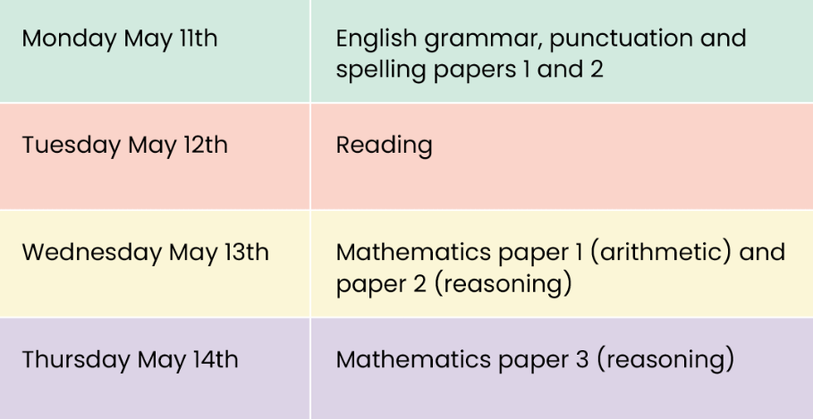
Dates for 2025-2026
All tests are marked externally.
Writing and Science are assessed internally by class teachers.

Slide 3
Grammar, Punctuation and Spelling (GPS/SPAG)
A spelling test is administered, containing 20 words. This takes approximately 15 minutes.
Words are given in the context of a sentence, and repeated twice.
Children are encouraged to block print their spellings words to ensure all letters are legible to external moderators when being marked
A separate test is given on grammar, punctuation and vocabulary, referred to as GPS.
This test lasts for 45 minutes and requires short answer questions including some multiple choice.
Marks for these two tests are added together to give a total score for grammar, punctuation and spelling

Slide 4
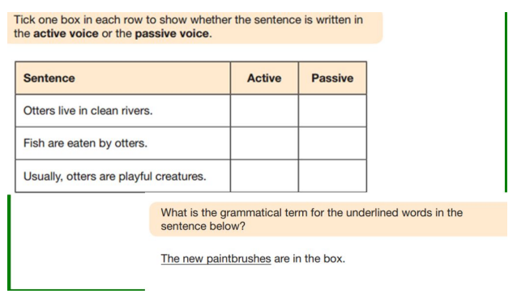
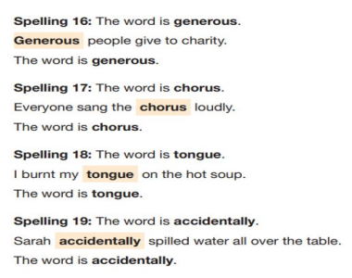
Example tests:
BBC Bitesize SPAG support and quizzes

Slide 5
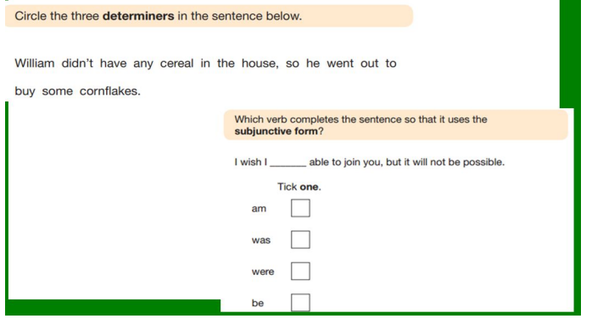

Slide 6
Reading
The reading test is a single paper, with 3 unrelated reading texts. Children are given 60 minutes in total, which includes reading the texts and answering questions about them.
A total of 50 marks is available
Questions are designed to assess the comprehension and understanding of a child’s reading.
During the reading paper, a child’s retrieval, prediction, inference and deduction skills are thoroughly tested.
Some questions are multiple choice or selected response; others require short answers and some require an extended response or explanation.

Slide 7
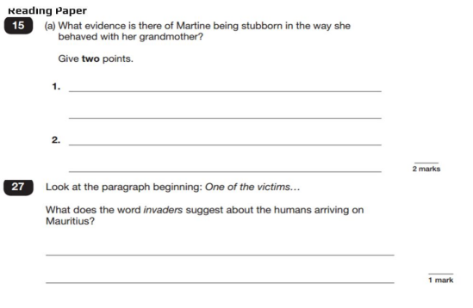
Example
tests:

Slide 8
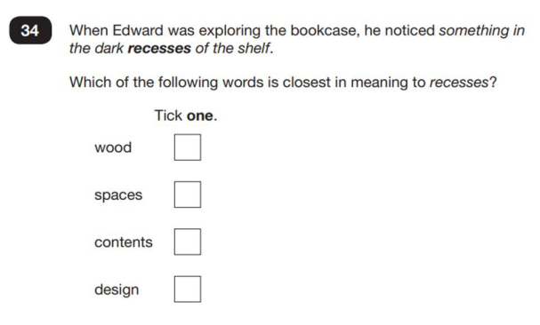

Slide 9
Maths
Children will sit three tests: paper 1, paper 2 and paper 3.
Paper 1 is for arithmetic and lasts for 30 minutes. This covers calculation methods (addition, subtraction, multiplication and division) including the use of fractions, decimals and percentages.
Questions gradually increase in difficulty. Not all children will be expected to access some of the more difficult questions later in the paper.
Papers 2 and 3 cover reasoning and problem solving, each lasting for 40 minutes.
Pupils will still require calculations skills but will need to answer questions in context and decide what is required to find the solution.

Slide 10
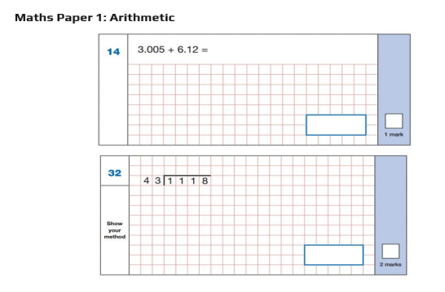
Example
tests:
BBC Bitesize Maths support and quizzes

Slide 11
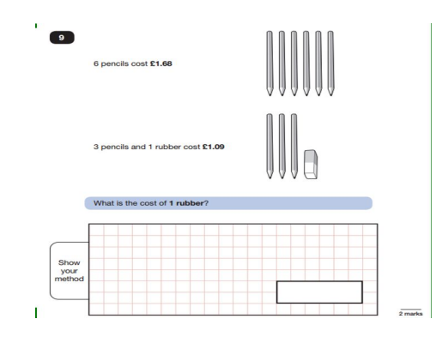

Slide 12
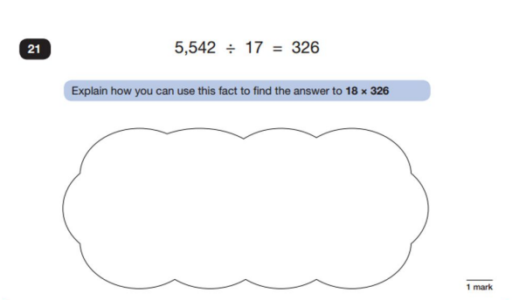

Slide 13
Writing
Writing is assessed by class teachers, alongside Senior Leadership Team.
Children are assessed as:
  Working below expected standard
  Working towards expected standard
  Working at expected standard
  Working at greater depth

Slide 14
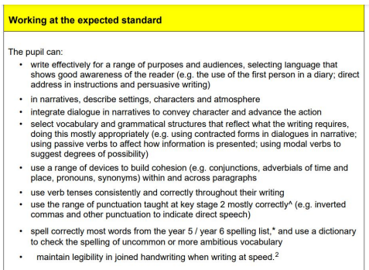

Slide 15
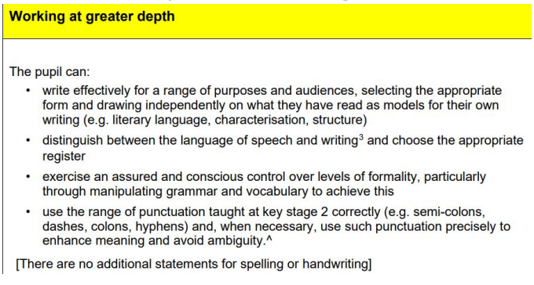

Slide 16
Results
Raw scores are translated into Scaled scores.
A scaled score of 100 will always represent the ‘national standard’ and any child who scores 100 + will have met the expected standard for that test and curriculum area.
Using the scaled score, the lowest a child can score is 80
Using the scaled score, the highest a child can score is 120
There is an additional boundary, usually set at around 110 scaled score. Any child scoring above 110 is considered to be working at a greater depth level.

Slide 17
How you can help
Ensure your child is well rested and has had a good breakfast on the morning of their tests.
Try and limit the stress and pressure on the tests.
Support your child with any revision, areas where they feel wobbly.
Spelling – Year 5 and 6 spelling words
GPS – BBC Bitesize revision guides and videos
Arithmetic – revision guide on Google Classroom
Reasoning – CGP and other SATS revision guides available to purchase
General maths revision in SATS revision folder

