Slide 1

Welcome to Birch class
Meet the teacher September 2025
Respect Independence Community Kindness

Slide 2

Agenda…
Meet the team
School uniform and PE
Break time
Termly curriculum overviews
Home learning activities
Morning and afternoon routines
Timetable
Roles and responsibilities
Trips and visits and future events
Questions

Slide 3

Meet the team…
Mrs Machin
I ABSOLUTELY love being surrounded by young people all day and couldn’t think of a better job! I just love teaching!
I have fabulous 5 year old twin daughters, and love walking, travelling, skiing, cooking and gardening. I also love a cheeseboard!
I have been teaching for 16 years, have a degree in Geography and Economics, a PGCE and an MA in Education.
Mrs Arkell
I’ve worked at KE for many years across all year groups, but my love is definitely UKS2. My favourite subject is Maths, as your children will know!
I have two gorgeous daughters whom I love spending time with. I enjoy walking, cycling, gardening or simply chilling with friends over a coffee or a glass of something.
And whenever possible I’ll always have my nose in a good book!
Mrs Watts
I am a qualified teacher with many years experience of working with children of all ages and abilities. I am a mum of three girls, one of which is currently at Kidmore End, the other two have been through the school and now at Gillotts.
We all love being here at Kidmore and looking forward to the coming year.
Mrs James
I have been working at Kidmore End for 6 years & both my sons came here.
I spent several years of my childhood living on a boat in the med - this lead me to work on 2 millionaires yachts.
My main hobby has been motor racing, racing Porsches and Lotus 7's, and met my husband racing against him!

Slide 4

School uniform expectations, a reminder…
It has been wonderful to see your children looking so smart!
Navy Skirt, Pinafore Dress or Smart Trousers or Red & White Gingham Dress in Summer (optional)
Grey Shorts or Trousers
Red School Polo Shirt*
Navy School Sweatshirt or Cardigan *
Navy or white knee-length socks or navy tights
Grey socks
Black shoes, not trainers or ankle boots
Details of the uniform can be found on our website:
https://www.kidmore-end.co.uk/parents/school-uniform
PLEASE NAME EVERYTHING!

Slide 5
PE days…
Your child needs to come to school wearing their PE uniform on their PE days.
Details of the uniform can be found on our website:
https://www.kidmore-end.co.uk/parents/school-uniform
The PE uniform is:
  Red School PE T-Shirt
  Navy Shorts
  Navy Tracksuit bottoms
  Plain Navy PE Jumper or School sweatshirt (Year 6 can add here about Leavers’ hoodies)
  Trainers
We have PE on a:
  Wednesday and Friday
  AWP Tuesdays and Thursdays – bring a pair of trainers to change into for lunch time

Slide 6
Breaktime
Reminder regarding snacks:
If your child needs a snack/energy boost at break time, please remember we are a healthy school.
Suggested snacks include: fruit, vegetables, cereal bars (no nuts), or fruit bars. No crisps please.

Slide 7

Termly curriculum overviews…
These will be emailed out termly
They give an overview of our learning for the term across all areas of the curriculum

Slide 8
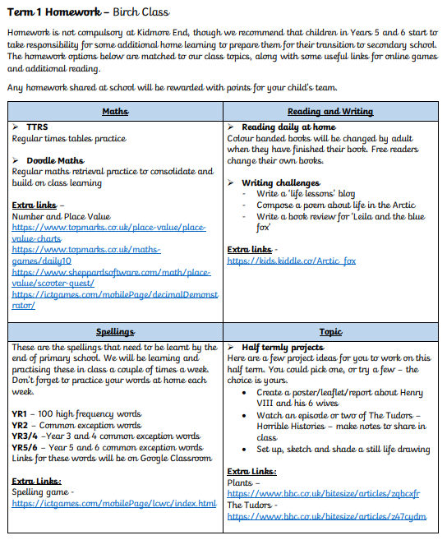


Home learning activities and expectations…
Daily reading and reading records
Spellings (CEW, HFW, Year 3 and 4 words, Year 5 and 6 words)
Doodlemaths Times Table Rockstars (KS2)
Termly projects and home learning

Slide 9
The morning and home time routine…
Morning
  Gates open at 8.30am
  Bell is rung at 8.35am. Children can start to enter school from this time
  Registration is at 8.45am – arriving after this time will result in your child being marked as late in the register
  If arriving after 8.45am, please enter through the front entrance
Afternoon
  Gates open at 3.10pm
  Children are dismissed at 3.15pm

Slide 10
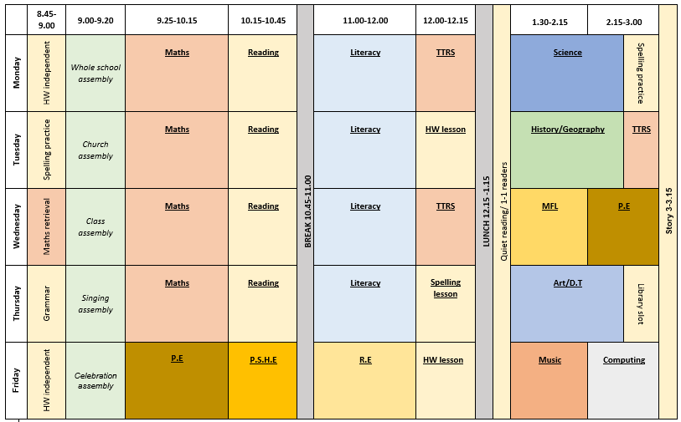
Our timetable

Slide 11
Roles and responsibilities …
School council (Y1 – Y6. Elected by class after ‘speech’)
Eco council (Y1 – Y6. Elected by class after ‘speech’)
Prefects (Y6. Application to Miss Spankie)
Playground leaders (Y6)
Team captains (Y6. ‘Speech’ then voted by Teams)
Buddies (Y5)
Librarians (Y5)

Slide 12
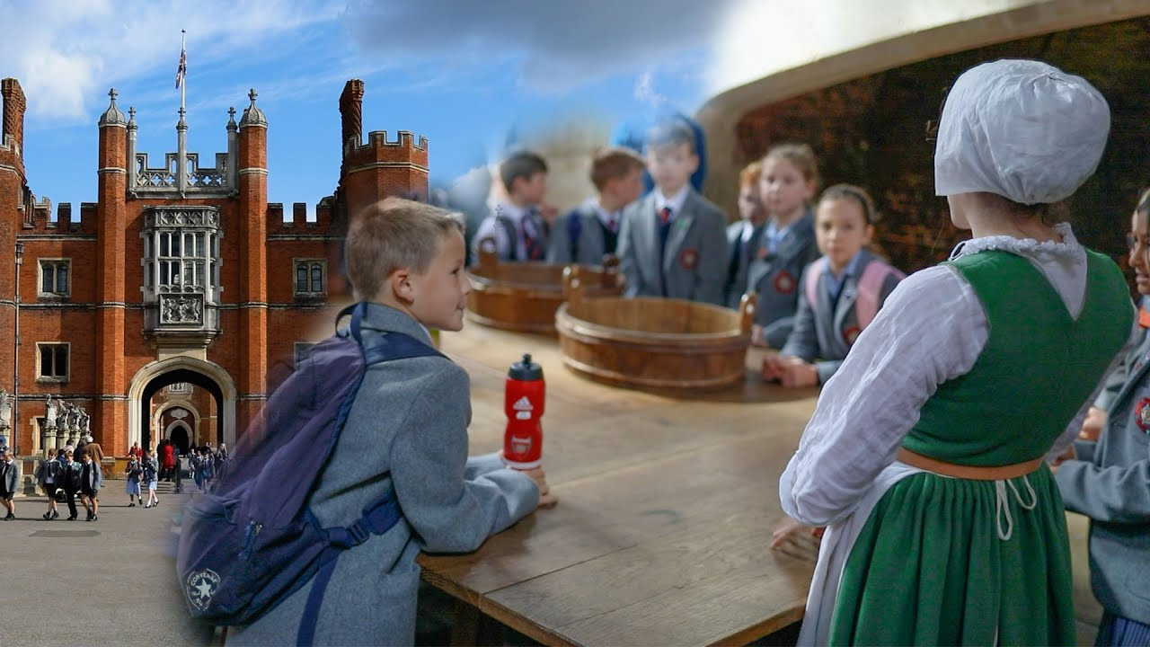
Trips and visits this year…
Autumn term
  Woodlands (Year 6)
  Hampton Court
Spring term
  Hindu temple TBC
  Hill End (Year 5)
Summer term
  TBC

Slide 13
Future events…
Parents evening – Week commencing 20th October
KESA events
Christmas events
Further details and dates will be emailed and included in the weekly school newsletter
Please arrange a meeting or phone call with me if you have any concerns or questions

Slide 14

Questions…

