Slide 1

Welcome to Sycamore class
Meet the teacher September 2025
Respect Independence Community Kindness

Slide 2

Agenda…
Meet the team
School uniform and PE
Break time
Termly curriculum overviews
Home learning activities
Morning and afternoon routines
Timetable
Roles and responsibilities
Trips and visits and future events
Questions

Slide 3

Meet the team…
Mrs Walker
I am so excited to work with Sycamore class this year. Teaching is my passion and working with amazing students and fantastic staff, at Kidmore End each day is a privilege. I have been a primary school teacher for over 9 years and have been fortunate to teach both in the UK and Australia.
This year I have also taken on the role of SENCo, which is incredibly exciting.
Mrs Wilson
I have worked as a TA at Kidmore End for 10 years now, across years 4, 5 and 6. I am excited to work in Sycamore class this year and I’m really looking forward to supporting your wonderful children. This year I have also taken on the role of Staff Governor.
Mrs Watts
I am a qualified teacher with many years experience of working with children of all ages and abilities. I am a mum of three girls, one of which is currently at Kidmore End, the other two have been through the school and now at Gillotts.
We all love being here at Kidmore and looking forward to the coming year.
Miss Jones
TA for 3 years including 1-1 roles. I love working with children in the school environment, its energising, uplifting and I've a personal passion for learning. I spent 20 years as a project manager in the construction industry prior and have enjoyed time travelling. I've current experience in Speech and language therapy. I particularly enjoy being a Mum, wild swimming, crochet and crafting, music and following space industry explorations!

Slide 4

School uniform expectations, a reminder…
It has been wonderful to see your children looking so smart!
Navy Skirt, Pinafore Dress or Smart Trousers or Red & White Gingham Dress in Summer (optional)
Grey Shorts or Trousers
Red School Polo Shirt*
Navy School Sweatshirt or Cardigan *
Navy or white knee-length socks or navy tights
Grey socks
Black shoes, not trainers or ankle boots
Details of the uniform can be found on our website:
https://www.kidmore-end.co.uk/parents/school-uniform
PLEASE NAME EVERYTHING!

Slide 5
PE days…
Your child needs to come to school wearing their PE uniform on their PE days.
Details of the uniform can be found on our website:
https://www.kidmore-end.co.uk/parents/school-uniform
The PE uniform is:
Red School PE T-Shirt
Navy Shorts
Navy Tracksuit bottoms
Plain Navy PE Jumper or School sweatshirt
Trainers
We have PE on a:
Wednesday and Thursday
AWP – bring a pair of trainers to change into for lunch time
Tuesdays and Thursdays (Years 5 and 6)
Wednesdays and Friday (Years 3 and 4)

Slide 6
Breaktime
Reminder regarding snacks:
If your child needs a snack/energy boost at break time, please remember we are a healthy school.
Suggested snacks include: fruit, vegetables, cereal bars (no nuts), or fruit bars. No crisps please.

Slide 7

Termly curriculum overviews…
These will be emailed out termly
They give an overview of our learning for the term across all areas of the curriculum

Slide 8
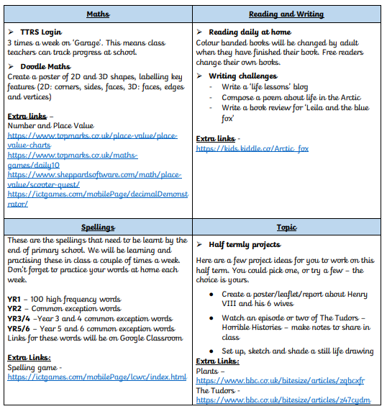


Home learning activities and expectations…
Daily reading and reading records
Spellings (CEW, HFW, Year 3 and 4 words, Year 5 and 6 words)
Doodlemaths, Times Table Rockstars (KS2)
Termly projects and home learning

Slide 9
The morning and home time routine…
Morning
Gates open at 8.30am
Bell is rung at 8.35am. Children can start to enter school from this time
Registration is at 8.45am – arriving after this time will result in your child being marked as late in the register
If arriving after 8.45am, please enter through the front entrance
Afternoon
Gates open at 3.10pm
Children are dismissed at 3.15pm

Slide 10
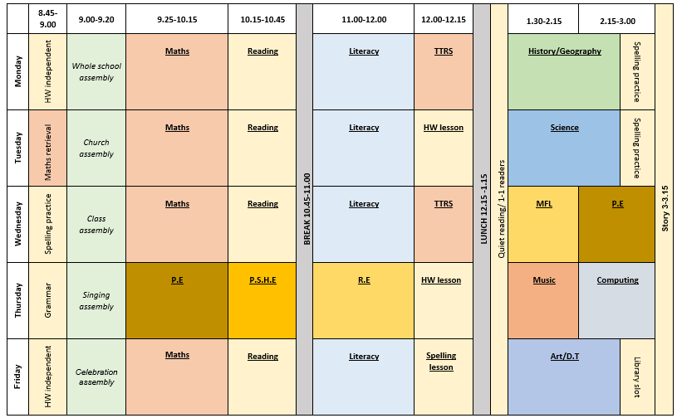
Our timetable

Slide 11
Roles and responsibilities …
School council (Y1 – Y6. Elected by class after ‘speech’)
Eco council (Y1 – Y6. Elected by class after ‘speech’)
Prefects (Y6. Application to Miss Spankie)
Playground leaders (Y6)
Team captains (Y6. ‘Speech’ then voted by Teams)
Buddies (Y5)
Librarians (Y5)

Slide 12
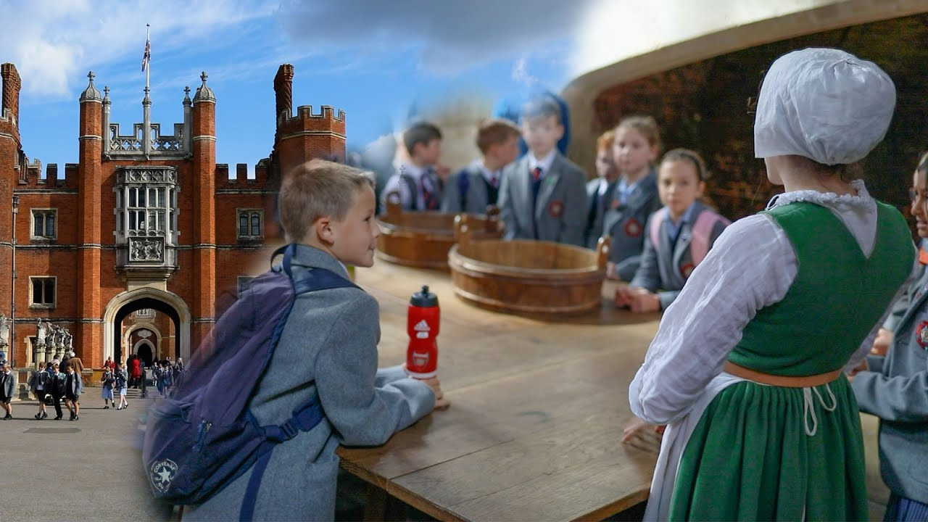
Trips and visits this year…
Autumn term
Hampton Court
Spring term
Hindu temple TBC
Hill End (Year 5)
Summer term
TBC

Slide 13
Future events…
Parents evening – Week commencing 20th October
KESA events
Christmas events
Further details and dates will be emailed and included in the weekly school newsletter
Please arrange a meeting or phone call with me if you have any concerns or questions

Slide 14

Questions…

