Slide 1

Welcome to Cedar class
Meet the teacher September 2025
Respect Independence Community Kindness

Slide 2

Agenda…
Meet the team
School uniform and PE
Breaktime
Termly curriculum overviews
Home learning activities
Morning and afternoon routines
Timetable
Roles and responsibilities
Trips and visits and future events
Questions

Slide 3

Meet the team…
Mrs Smith
I love teaching in Year 1! The children make such amazing progress. It is a privilege to be a part of their young lives.
Six years ago I retrained as a teacher and I have spent most of my teaching time in Year 1. Before that I had a career in Marketing and Market Research. I am married with three children aged 21, 19 and 16. I love to travel and enjoy keeping fit, especially walking our cockapoo called Oscar!
Miss Williams
I have been at Kidmore-End as a TA since February. I am also a swimming teacher and coach. I love working with children and watching them grow. I have two daughters at this school, Sophie in Year 5 and Hailie in Year 2. My youngest, Maddison, will hopefully join next year!

Slide 4

School uniform expectations, a reminder…
It has been wonderful to see your children looking so smart!
Navy Skirt, Pinafore Dress or Smart Trousers or Red & White Gingham Dress in Summer (optional)
Grey Shorts or Trousers
Red School Polo Shirt*
Navy School Sweatshirt or Cardigan *
Navy or white knee-length socks or navy tights
Grey socks
Black shoes, not trainers or ankle boots
Details of the uniform can be found on our website:
https://www.kidmore-end.co.uk/parents/school-uniform
PLEASE NAME EVERYTHING! A MARKER PEN IS FINE!

Slide 5
PE days…
Your child needs to come to school wearing their PE uniform on their PE days.
Details of the uniform can be found on our website:
https://www.kidmore-end.co.uk/parents/school-uniform
The PE uniform is:
  Red School PE T-Shirt
  Navy Shorts
  Navy Tracksuit bottoms
  Plain Navy PE Jumper or School sweatshirt
  Trainers
We have PE on a:
  Wednesday
  Friday
  AWP - Tuesday, Wednesday, Thursday & Friday morning break - children will need to change into non marking trainers.

Slide 6
Breaktime
Reminder regarding snacks:
If your child needs a snack/energy boost at break time, please remember we are a healthy school.
Suggested snacks include: fruit, vegetables, cereal bars (no nuts), or fruit bars. No crisps please.
A fruit or vegetable snack is provided for Cedar Class.

Slide 7
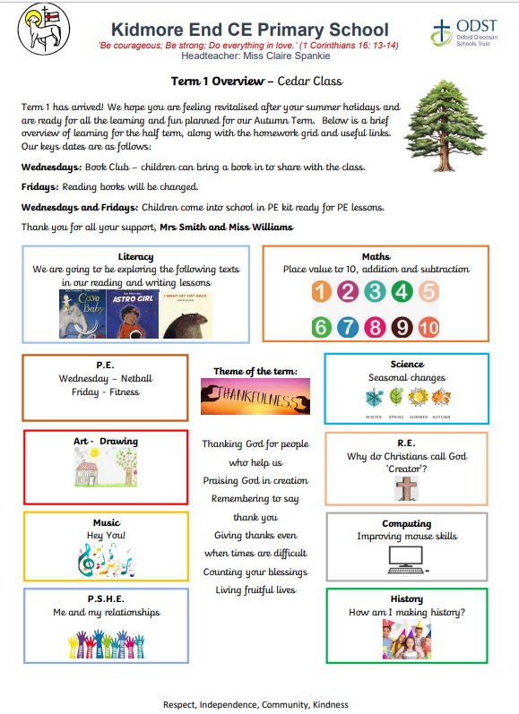
Termly curriculum overviews…
These will be emailed out termly
They give an overview of our learning for the term across all areas of the curriculum
  Wednesday – Book Club
  Thursday – Library Slot
  Friday – Books changed

Slide 8
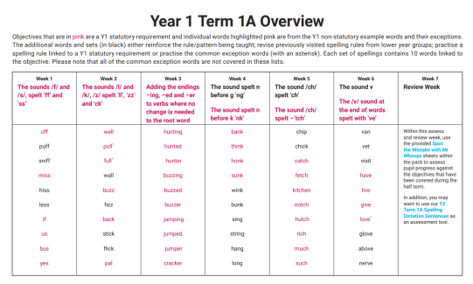

Home learning activities and expectations…
Daily reading and reading records
Spelling practise
Numbots
Termly projects – Family Tree – w/c 6th October

Slide 9
The morning and home time routine…
Morning
  Gates open at 8.30am
  Bell is rung at 8.35am. Children can start to enter school from this time
  Children come into class and start a fine motor activity
  Registration is at 8.45am – arriving after this time will result in your child being marked as late in the register
  If arriving after 8.45am, please enter through the front entrance
Afternoon
  Gates open at 3.10pm
  Children are dismissed at 3.15pm

Slide 10
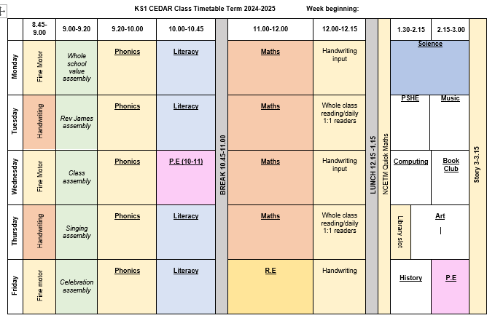
Our timetable

Slide 11
Roles and responsibilities …
School council (2 elected by class after ‘speech’)
Eco council (2 elected by class after ‘speech’)

Slide 12
Trips and visits this year…
Autumn term
  Walk around Kidmore-End (Local Geography Topic)
Spring term
  Trip to Milestones Museum (Toys Topic)
Summer term
  Trip to Earth Trust (Plants Topic)

Slide 13
Future events…
Parents evening – Week commencing 20th October
KESA events
Christmas events – Nativity!
Further details and dates will be emailed and included in the weekly school newsletter
Phonics Screening Check – w/c 8th June 2026
Please arrange a meeting or phone call with me if you have any concerns or questions

Slide 14

Questions…

