Slide 1

Welcome to Ash class
Meet the teacher September 2025
Respect Independence Community Kindness

Slide 2

Agenda…
Meet the team
School uniform and PE
Break time
Termly curriculum overviews
Home learning activities
Morning and afternoon routines
Timetable
Roles and responsibilities
Trips and visits and future events
Questions

Slide 3

Meet the team…
Teacher – Mrs Salt
I have worked here for 15 years and am the longest serving teacher in this school. I have previously have taught in all year groups. Currently, I am curriculum lead for music.
I have two grown up children. My interests are music (live gigs, playing piano, guitar, violin) running (very beginner level!), walking in the Lake District and gardening.
Teacher –Miss Talbot
I am new to Kidmore End and previously taught at a school in Caversham I have been teaching for 17 years!
I have two small children that I look after on the days that I am not working. My interests are sport, being outside and going to the gym.
Teaching Assistant – Mrs Williams
I have worked here for 17 years as a teaching assistant. I was a pupil here myself, as were my two children, who are now grown up.
I am the school’s Emotional Literacy Support Assistant and support children across the school. I am also part of the team who run our After School Club.
I love animals, especially my dog and used to keep horses.
Teacher Assistant – Mrs
Sergent
I am fairly new to Kidmore End, having only worked here for half a term before summer.
I have two small children and a dog, all of who keep me busy around my work life. I enjoy shopping and spending time outside with my family and friends.

Slide 4

School uniform expectations, a reminder…
It has been wonderful to see your children looking so smart!
Navy Skirt, Pinafore Dress or Smart Trousers or Red & White Gingham Dress in Summer (optional)
Grey Shorts or Trousers
Red School Polo Shirt*
Navy School Sweatshirt or Cardigan *
Navy or white knee-length socks or navy tights
Grey socks
Black shoes, not trainers or ankle boots
Details of the uniform can be found on our website:
https://www.kidmore-end.co.uk/parents/school-uniform
PLEASE NAME EVERYTHING!

Slide 5
PE days…
Your child needs to come to school wearing their PE uniform on their PE days.
Details of the uniform can be found on our website:
https://www.kidmore-end.co.uk/parents/school-uniform
The PE uniform is:
  Red School PE T-Shirt
  Navy Shorts
  Navy Tracksuit bottoms
  Plain Navy PE Jumper or School sweatshirt
  Trainers
We have PE on a:
  Wednesday
  Thursday
  AWP Morning break time – must have trainers to change into

Slide 6
Break time
Reminder regarding snacks:
If your child needs a snack/energy boost at break time, please remember we are a healthy school.
Suggested snacks include: fruit, vegetables, cereal bars (no nuts), or fruit bars. No crisps please.

Slide 7

Termly curriculum overviews…
These will be emailed out termly
They give an overview of our learning for the term across all areas of the curriculum

Slide 8
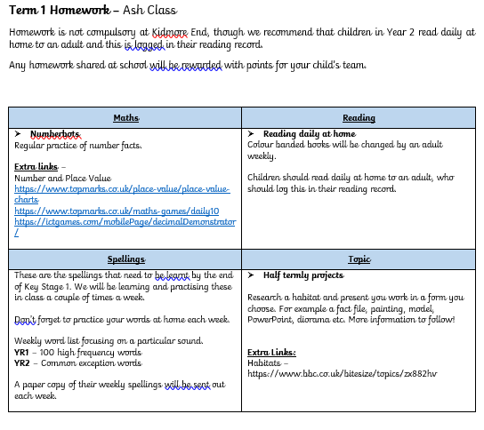

Home learning activities and expectations…
Daily reading and reading records
Spelling practise
Numbots

Slide 9
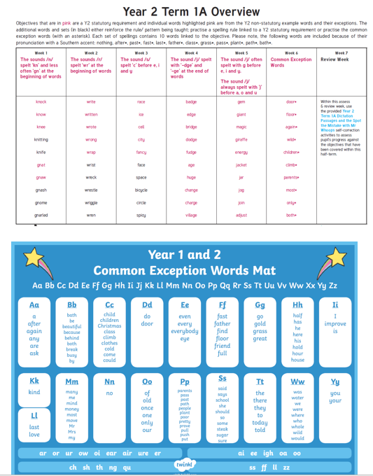

Slide 10

Home learning activities and expectations…
Daily reading and reading records
Spellings (CEW, HFW, Year 1 and 2 words)
Numbots
Termly projects and home learning

Slide 11
The morning and home time routine…
Morning
  Gates open at 8.30am
  Bell is rung at 8.35am. Children can start to enter school from this time
  Registration is at 8.45am – arriving after this time will result in your child being marked as late in the register
  If arriving after 8.45am, please enter through the front entrance
Afternoon
  Gates open at 3.10pm
  Children are dismissed at 3.15pm

Slide 12
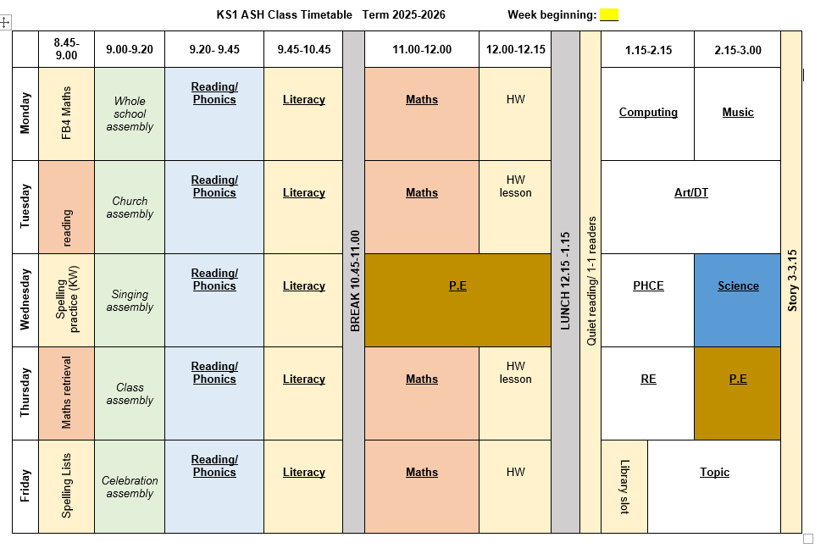
Our timetable

Slide 13
Roles and responsibilities …
School council (Elected by class after ‘speech’)
Eco council (Elected by class after ‘speech’)
Years 5/6
Prefects
Playground leaders
Team captains
Buddies
Librarians

Slide 14
Trips and visits this year…
Autumn term
  Rabbi to visit TBC
Spring term
  Story Museum Oxford TBC
Summer term
  Windsor Castle

Slide 15
Future events…
Parents evening – Week commencing 20th October
KESA events
Christmas events
Further details and dates will be emailed and included in the weekly school newsletter
Please arrange a meeting or phone call with me if you have any concerns or questions

Slide 16

Questions…

