Slide 1

Welcome to Cherry class
Meet the teacher September 2025
Respect Independence Community Kindness

Slide 2

Agenda…
Meet the team
School uniform and PE
Morning and afternoon routines
Termly curriculum overviews
Timetable
Phonics and Reading
Roles and responsibilities
Trips and visits and future events
Questions

Slide 3

Meet the team…
Mrs Hinnell
I have been teaching for 21 years!!!! I started my teaching career in secondary and I’ve taught all key stages and now I’m in my favourite place!!! I love the freedom of the Early Years Framework and being able to follow the individual child’s interests.
I’m kept very busy at home with my 3 boys and I spend a lot of time on the side of football pitches drinking coffee! I love reading, going to the theatre and dancing.
Miss Morris
I have worked in early years for 25 years. I have been a Nanny for the same family for 16 years. I have been at Kidmore End School for 10 years. I love going to the gym, reading and I like football. I support Reading and Man Utd.
Mrs Williams
I have worked at Kidmore End since 2017 and enjoyed working across different years, but it is a joy to be back in Foundation Stage. When I’m not at work , I enjoy walking my sausage dog in the woods.

Slide 4

School uniform expectations, a reminder…
It has been wonderful to see your children looking so smart!
Navy Skirt, Pinafore Dress or Smart Trousers or Red & White Gingham Dress in Summer (optional)
Grey Shorts or Trousers
Red School Polo Shirt*
Navy School Sweatshirt or Cardigan *
Navy or white knee-length socks or navy tights
Grey socks
Black shoes, not trainers or ankle boots
Details of the uniform can be found on our website:
https://www.kidmore-end.co.uk/parents/school-uniform
PLEASE NAME EVERYTHING!

Slide 5
PE days…
Your child needs to come to school wearing their PE uniform on their PE days.
Details of the uniform can be found on our website:
https://www.kidmore-end.co.uk/parents/school-uniform
The PE uniform is:
  Red School PE T-Shirt
  Navy Shorts
  Navy Tracksuit bottoms
  Plain Navy PE Jumper or School sweatshirt
  Trainers
We have PE on a:
  Monday
  Friday

Slide 6
The morning and home time routine…
Morning
  Gates open at 8.30am
  Bell is rung at 8.35am. Children can start to enter school from this time
  Registration is at 8.45am – arriving after this time will result in your child being marked as late in the register
  If arriving after 8.45am, please enter through the front entrance
Afternoon
  Gates open at 3.10pm
  Children are dismissed at 3.15pm
Notes:
Self registrationTable top activities in the morning.

Slide 7

Termly curriculum overviews…
These will be emailed out termly
They give an overview of our learning for the term across all areas of the curriculum

Slide 8
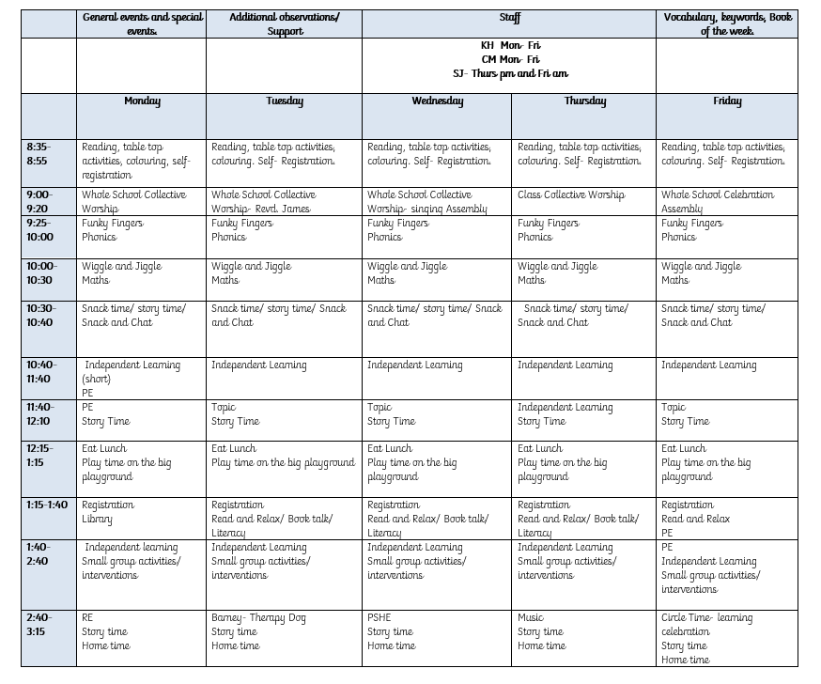
Our timetable

Slide 9
Phonics, Reading and home learning
Rising Stars Rocket Phonics scheme- Early Years and KS1 incorporates phonics and reading together
Daily phonics- whole class input then small groups covering pupil practice booklets, reading and fine motor skills activities
Blending and segmenting
Phonics sounds and common exception words (tricky words) are in reading records
Flashcards and reading books sent home
Daily home reading- lilac books, flashcards, I can blend cards, reading books. Please sign when finished. Books and flashcards changed on a Friday.
Handwriting sheets

Slide 10
Buddies
Year 5 buddies
Support and friendship on the playground
Learning activities
Shared reading

Slide 11
Trips and visits this year…
Autumn term
  Woodland walk and Den building
Spring term
  Bucklebury Farm visit
Summer term
  Science Centre

Slide 12
Future events…
Parents evening – Week commencing 20th October
KESA events
Christmas events- Nativity
Further details and dates will be emailed and included in the weekly school newsletter

Slide 13
General Information
Coat- every day
Water bottle- just water please. Please don’t put water bottles in the book bag!
Book bag with reading book and reading record- please check daily and remove notices and artwork etc.
Snack- optional but must be fruit or veg please
Spare clothes to stay at school
Wellies to stay at school
Show and tell- we’ll let you know when
Wow moments
Birthday books
Wish list
Please arrange a meeting or phone call with me if you have any concerns or questions

Slide 14

Questions…

