Slide 1

Welcome to Maple class
Meet the teacher September 2025
Respect Independence Community Kindness

Slide 2

Agenda…
Meet the team
School uniform and PE
Breaktime
Termly curriculum overviews
Home learning activities
Morning and afternoon routines
Timetable
Roles and responsibilities
Trips and visits and future events
Questions

Slide 3

Meet the team…
Mrs Clarke
I have been teaching in Primary schools for over 10 years, and have never taken for granted our lucky I am to do this job! It is my absolute passion so I am thrilled to return back to teaching here at Kidmore End after having a small break to raise my children (who also attend the school!)
I am also a qualified dance teacher and love to give my class any opportunity for a performance! Outside of work, I enjoy practising my own Ballet and spending time being ‘Mummy’!
Mrs Tindle-Rae
I am new to Kidmore End this year, but I taught in my previous school for 10 years! My original degree is in Zoology and I love sharing my passion for animals and science with the classes that I teach!
When I am not in school, I spend time with my twin daughters (they are nearly 4), training my Springerdoodle puppy Holly and re-decorating our new family home. I am a keen reader and sportswoman, I am hoping to spend more time on the golf course this year!
Mrs Laverick
Mrs Laverick has been working at Kidmore End since 2003. She started as a dinner lady before moving to become a 1:1 TA 4 years later. She has 3 children who all attended Kidmore End. Outside of school Mrs Laverick enjoys walking her two doggies and taking on different craft projects.

Slide 4

School uniform expectations, a reminder…
It has been wonderful to see your children looking so smart!
Navy Skirt, Pinafore Dress or Smart Trousers or Red & White Gingham Dress in Summer (optional)
Grey Shorts or Trousers
Red School Polo Shirt*
Navy School Sweatshirt or Cardigan *
Navy or white knee-length socks or navy tights
Grey socks
Black shoes, not trainers or ankle boots
Details of the uniform can be found on our website:
https://www.kidmore-end.co.uk/parents/school-uniform
PLEASE NAME EVERYTHING!

Slide 5
PE days…
Your child needs to come to school wearing their PE uniform on their PE days.
Details of the uniform can be found on our website:
https://www.kidmore-end.co.uk/parents/school-uniform
The PE uniform is:
Red School PE T-Shirt
Navy Shorts
Navy Tracksuit bottoms
Plain Navy PE Jumper or School sweatshirt
Trainers
We have PE on a:
Wednesday
Thursday
AWP Wednesday and Friday – bring a pair of trainers to change into for lunch time

Slide 6
Breaktime
Reminder regarding snacks:
If your child needs a snack/energy boost at break time, please remember we are a healthy school.
Suggested snacks include: fruit, vegetables, cereal bars (no nuts), or fruit bars. No crisps please.

Slide 7

Termly curriculum overviews…
These will be emailed out termly
They give an overview of our learning for the term across all areas of the curriculum

Slide 8
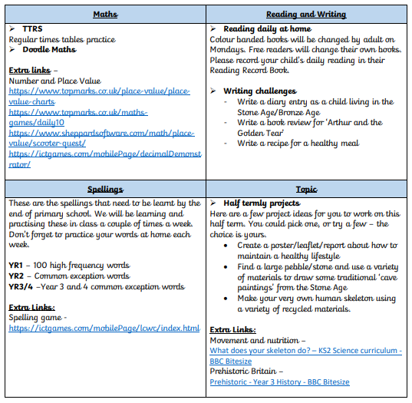


Home learning activities and expectations…
Daily reading and reading records- books changed every Monday.
Spellings (CEW, HFW, Year 3 and 4 words, Year 5 and 6 words)
Doodlemaths
Times Table Rockstars
Termly projects and home learning

Slide 9
The morning and home time routine…
Morning
Gates open at 8.30am
Bell is rung at 8.35am. Children can start to enter school from this time
Registration is at 8.45am – arriving after this time will result in your child being marked as late in the register
If arriving after 8.45am, please enter through the front entrance
Afternoon
Gates open at 3.10pm
Children are dismissed at 3.15pm (adults will only dismiss your child when we see you, or another designated adult)

Slide 10
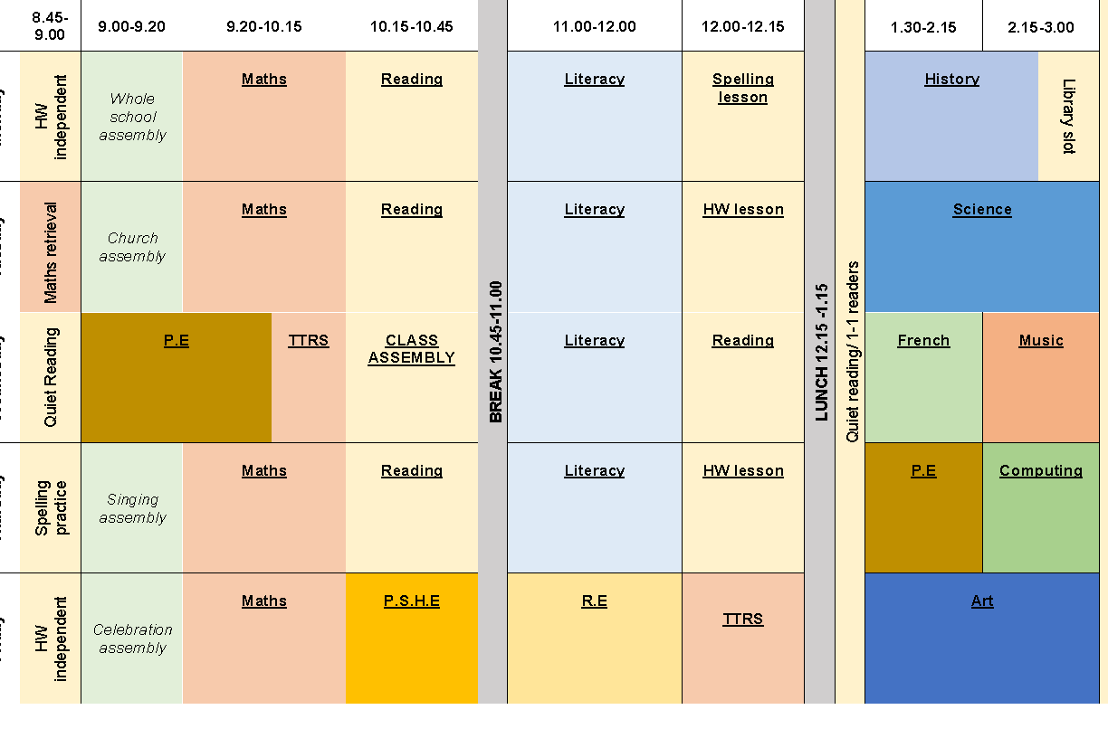
Our timetable

Slide 11
Roles and responsibilities …
School council (Elected by class after ‘speech’)
Eco council (Elected by class after ‘speech’)

Slide 12
Trips and visits this year…
There will be one trip/visit per term that will further extend key learning points from our Curriculum.
These will be communicated to you as soon as we have specific details.

Slide 13
Future events…
Parents evening – Week commencing 20th October
KESA events
Christmas events
Further details and dates will be emailed and included in the weekly school newsletter
Please arrange a meeting or phone call with me if you have any concerns or questions

Slide 14

Questions…

